Slide 1

Deploying and Managing Game Servers on AWS with CDK and Docker
February 2025

Slide 2



Sponsor
.com

Slide 3
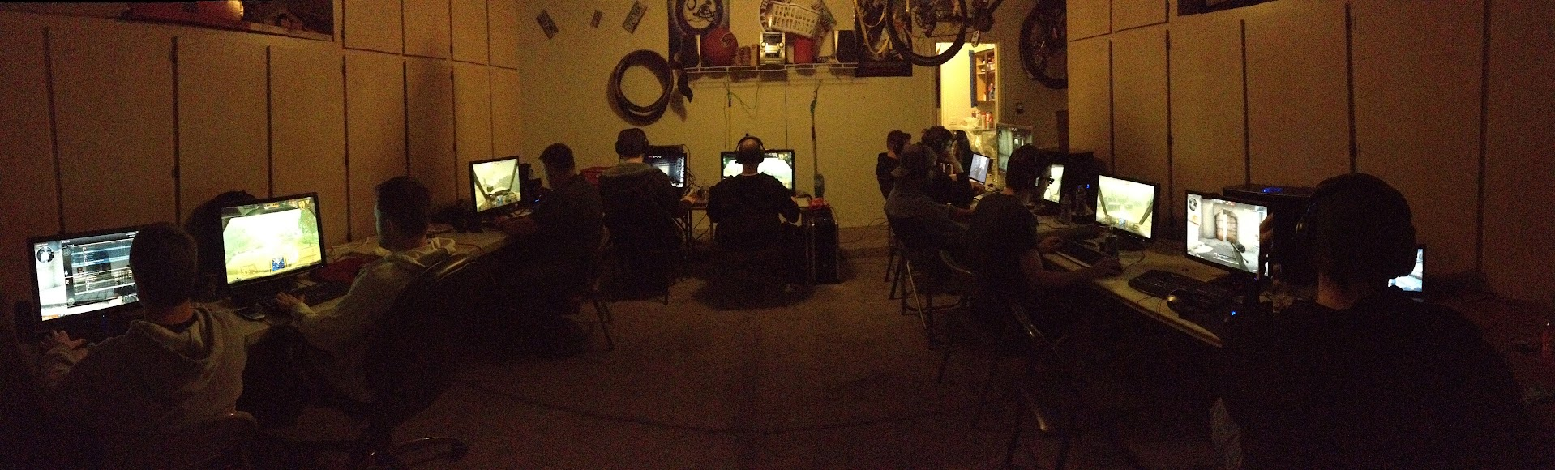
What is a LAN Party?
A LAN (Local Area Network) party is an event where gamers connect their computers to a shared local network, enabling multiplayer gameplay in the same physical location.
In the early 2000s, LAN parties were especially popular for FPS games like Quake, Counter-Strike, and Unreal Tournament. Hosting these events required setting up dedicated game servers, configuring network switches, and optimizing for low-latency gameplay—all of which depended on players bringing their own computers to a centralized space.
However, organizing a LAN party comes with several challenges, including network management, server hosting, and event coordination.
1 Managing firewalls and network infrastructure is boring.
2 Having to install servers from scratch and understand and know all app nuances is large in scope.
3 Hosting and organizing an event is challenging, from coordinating games to communicating the date and time to serving/sharing files. I want to play too!
Network Admin
Server Admin
Event Management

Slide 4
Considerations
Requirements
No servers to manage – less hassle
Minimal commitment to server and docker config – 3rd party repos
Docker containers - run app anywhere – in AWS or locally
Mechanisms for on-demand start/stop – Discord IAM usage
Website for promoting details and file sharing – Low-cost solution
Discord notifications - Webhooks
Prerequisites
CDK Bootstrap
Discord server
GitHub
AWS Account

Slide 5

Solution

Slide 6
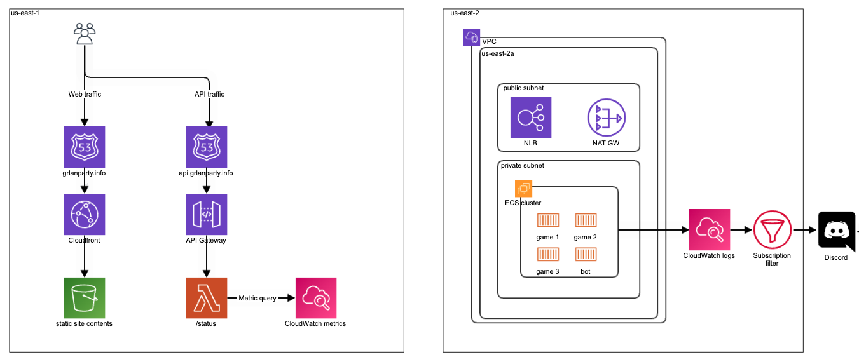

Infrastructure Overview

Slide 7
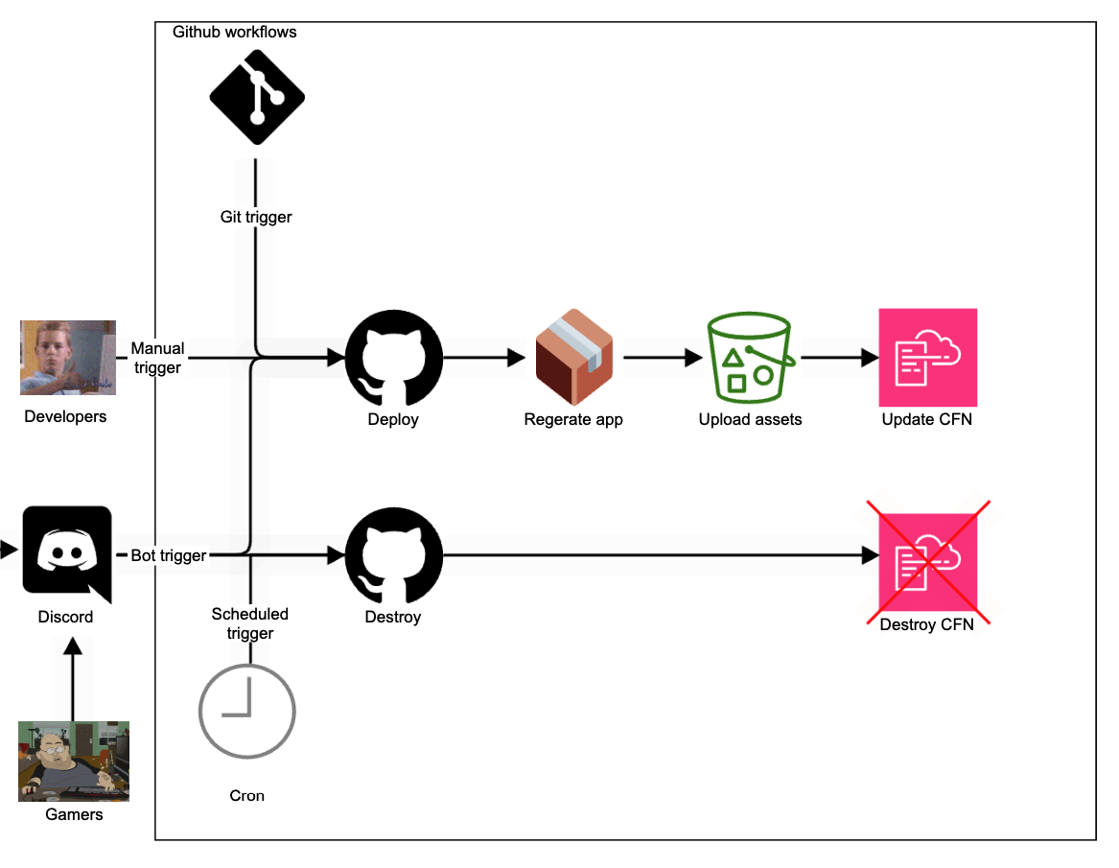

CI Overview

Slide 8
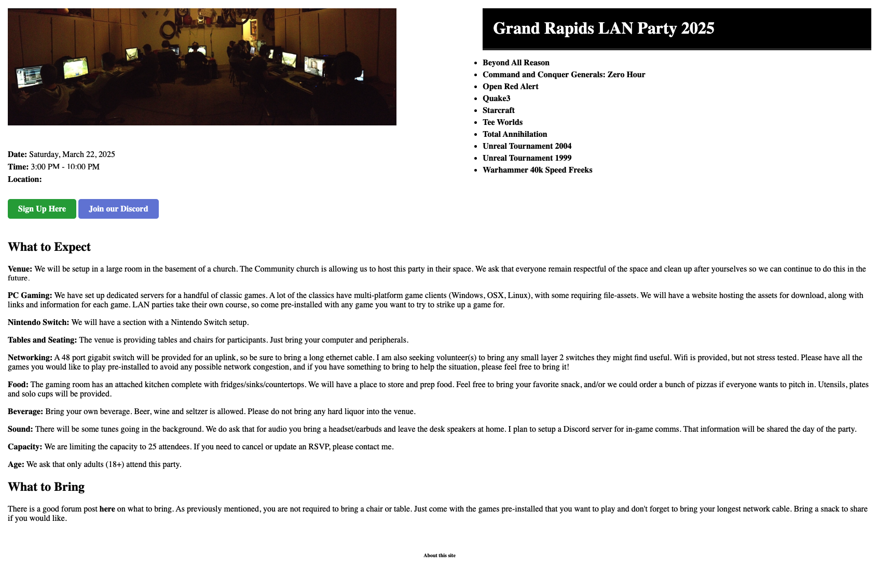
Website

Slide 9


Website
Serving Game Files & Assets: Hosts required mods, maps, and other assets for games that need additional files.
Displaying Server Status: Provides real-time or periodic updates on the status of each hosted game server.
Auto-Generated Pages: Uses Jinja2 templates to dynamically render documentation and info pages from each app’s README.
Low-Cost Hosting: S3 + CloudFront provides a cost-effective, scalable, and highly available solution compared to traditional web hosting.
Simple & Lightweight Design: Static site delivery ensures fast load times with minimal overhead, reducing complexity while maintaining flexibility.

Slide 10
Limitations
Limited Dynamic Content Handling
Static content is predictable but limited in its ability to process or query data. It heavily relies on API calls to operate.
Caching
Cloudfront caching is aggressive, and an invalidation must occur on every commit/update. This can be automated with CI, but it requires permission for the CI IAM principal to execute.
Complex Auth and Access Control
Implementing robust user authentication (e.g., OAuth, role-based access) requires external identity providers like Cognito or third-party services. Some frameworks have built-in auth, but are dynamic in nature (Django, Next, etc)

Slide 11

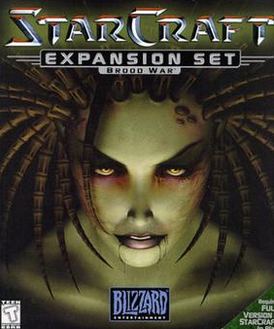


Games

Slide 12
Games
Single AZ Deployment: Simplifies networking and reduces costs while maintaining low-latency performance for game servers.
Shared Network Load Balancer (NLB): Provides a single-entry point for efficiently routing traffic to multiple game servers.
ECS Fargate: Runs Docker servers in a scalable, containerized environment with easy deployment.
Centralized Logging & Monitoring: CloudWatch log filters and alerts notify admins of server events, crashes, or player activity.
Optimized for LAN-Like Experience: Keeps server infrastructure lightweight and responsive, mimicking the low-latency feel of a traditional LAN party.

Slide 13
Limitations
Storage Limits
ECS tasks using Fargate are limited to 20GB of ephemeral storage, which may not be sufficient for games requiring large mod files, maps, or logs. I.e. Minecraft w/ lots of mods
Workaround: Offload persistent storage needs to EFS or S3.
Persistent Storage
Game servers that require persistent data (e.g., player saves, configs, logs) cannot rely on local storage, as ECS tasks may be rescheduled on a different node.
Solution: Mount EFS to retain data across task restarts, but this adds network latency compared to local disk access.
NLB/Target Limits
A single Network Load Balancer (NLB) supports a limited number of listeners and target groups. Running many different game servers may require additional NLBs.
ECS Services support only 5 TG targets with one per listener rule.
Single AZ Constraint
Running everything in a single availability zone (AZ) reduces complexity and latency but makes the system vulnerable to AZ failures.
Vertical Scaling
Compute must be scaled vertically due to client-to-server sessions being sticky and tied to a single server.

Slide 14
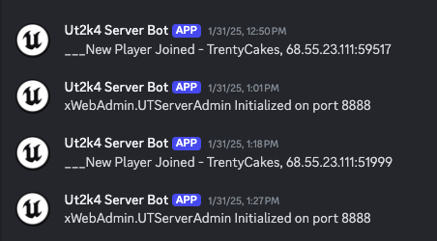
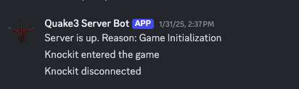
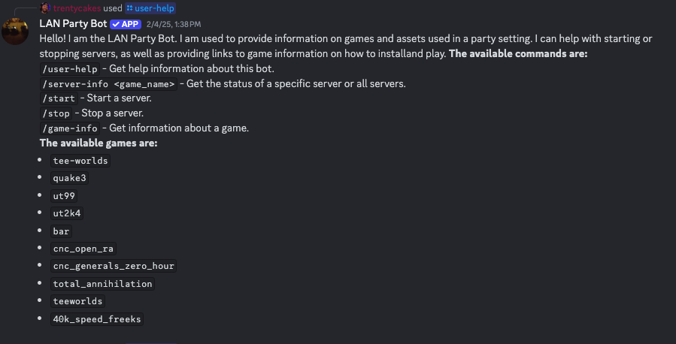
Discord

Slide 15
Discord
Event Webhooks: Simplifies incoming webhooks. Subscription filters can send messages to Discord easily.
Rely on Discord Roles: The Discord bot can be added to a server and then assigned to specific users of that server’s role. This grants access to status, deploy and destroy using Discord’s IAM mechanisms.
Easy Bot Interaction: Rather than relying on your peers knowing what GitHub is, allow your friends to use your server without teaching them the way.

Slide 16
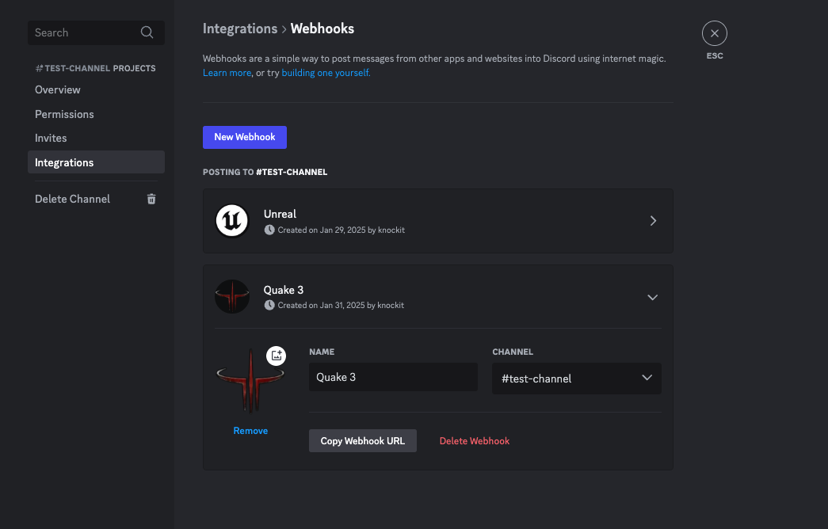
Incoming Webhooks

Slide 17
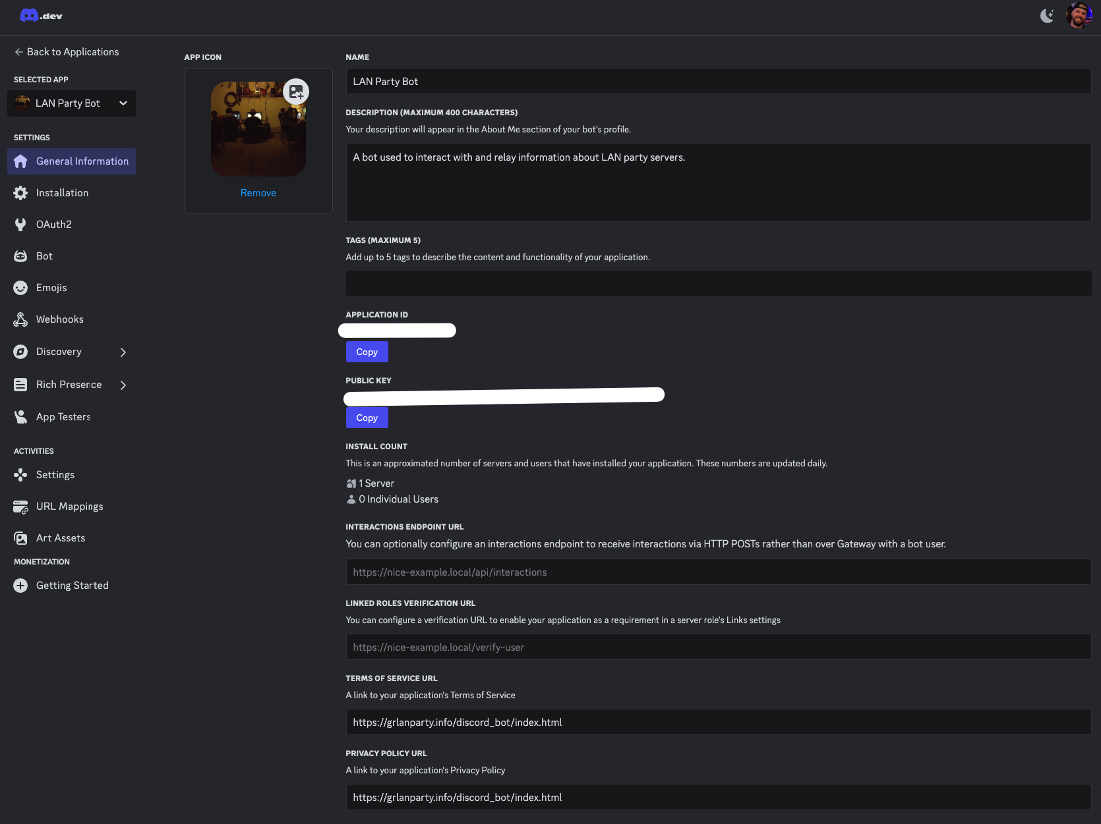
Bot
Config

Slide 18
Code demo/talk here

Slide 19
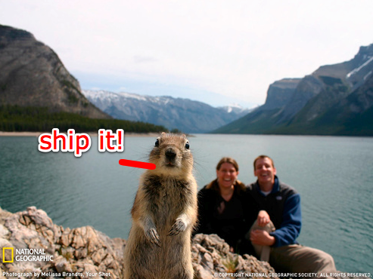
Deployment

Slide 20
GitHub Actions
Adhoc Deploy: Allow on-demand deployment of servers
Adhoc Destroy: Allows on-demand destruction of servers
Git Deploy: Trigger update of all stacks
Cron destroy ECS: Daily trigger to destroy all game servers at 5 am
Cron destroy NLB: Daily trigger to destroy all game servers at 4 30 am

Slide 21
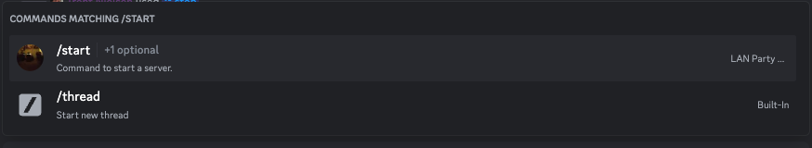
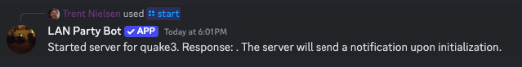
GitHub Actions
Managed via LAN Party Bot

Slide 22
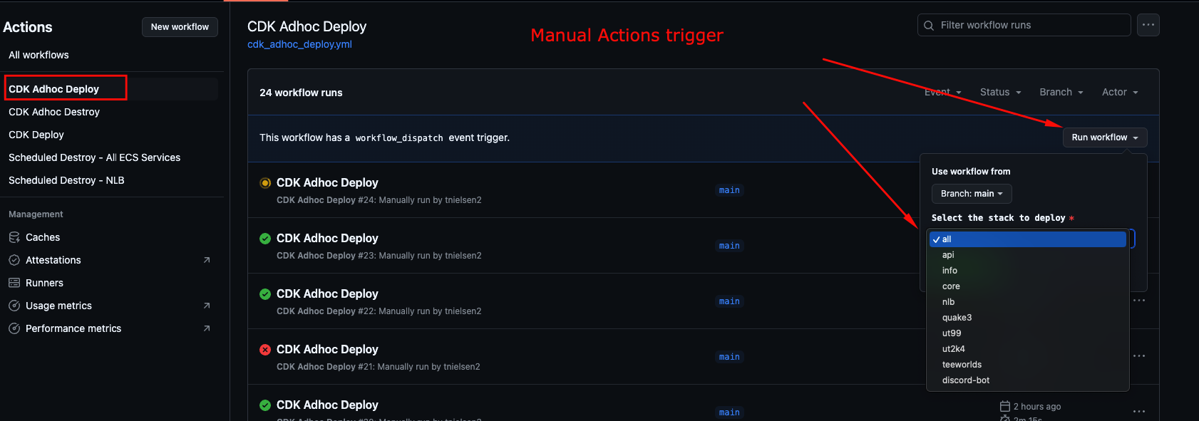
GitHub Actions
Managed via GitHub Actions

Slide 23
Monitoring

Slide 24
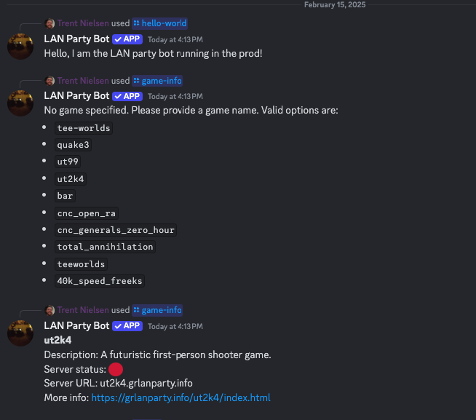
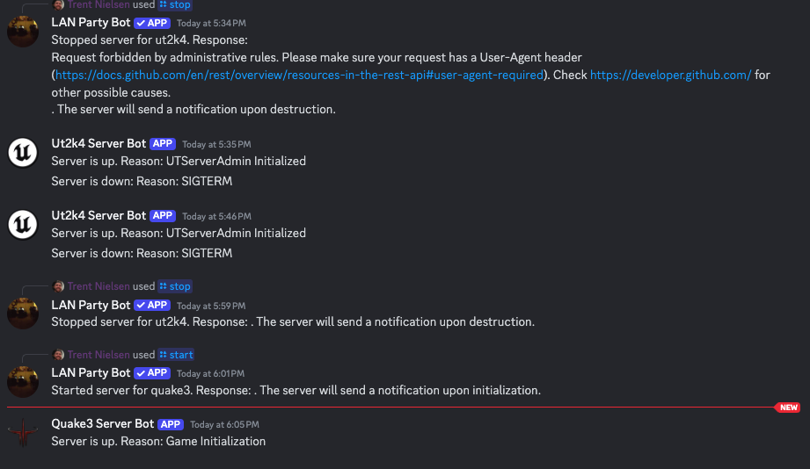
Alert Channels

Slide 25
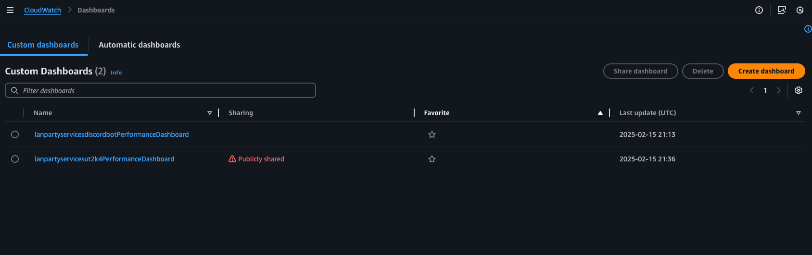
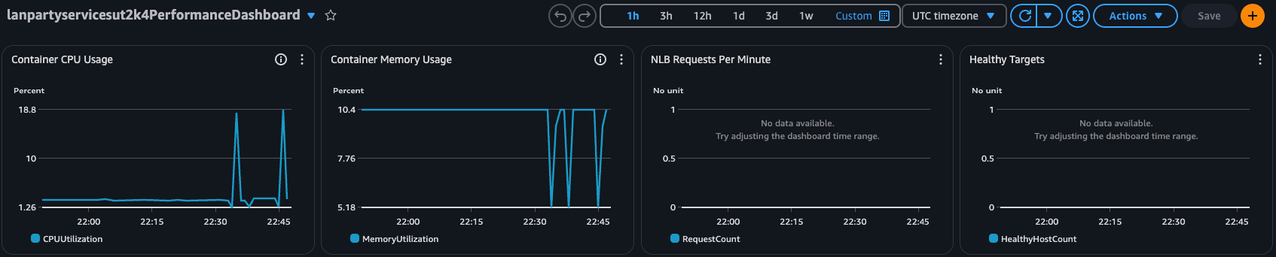
Dashboards

Slide 26

Cost

Slide 27
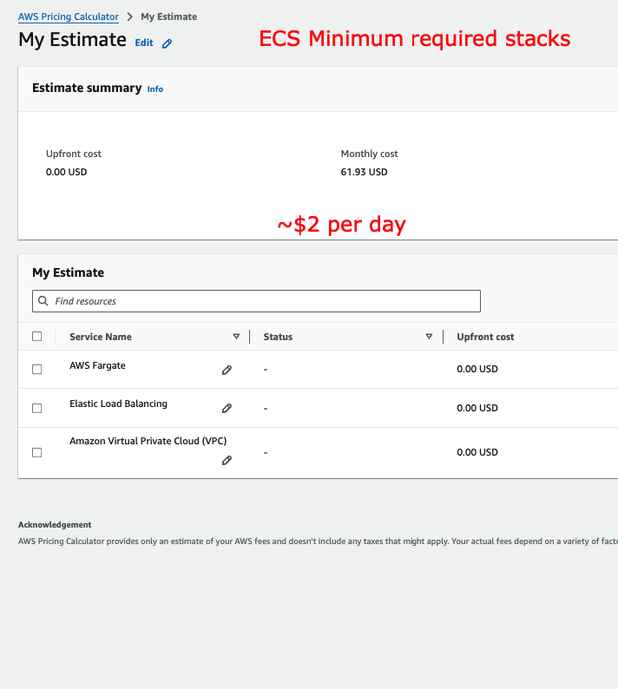
AWS Cost

Slide 28
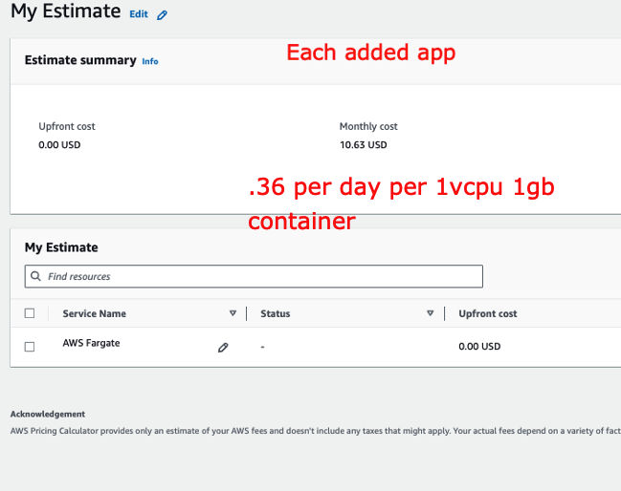
AWS Cost

Slide 29
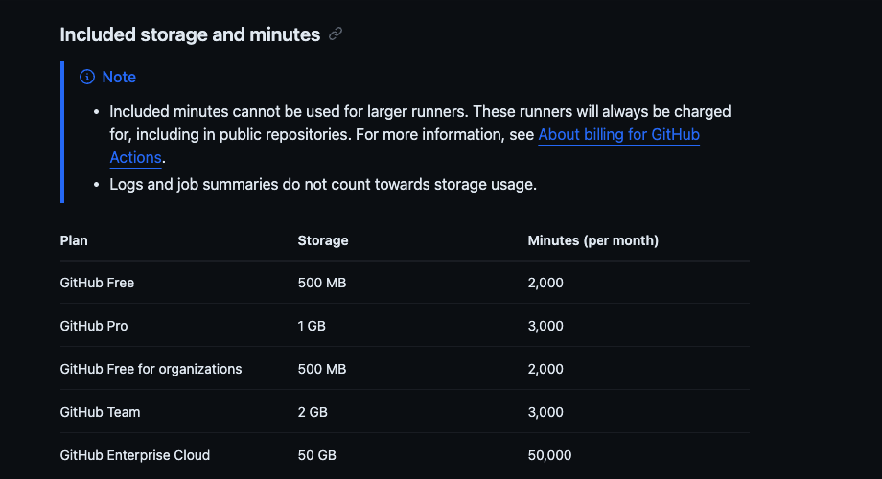
GitHub Cost

Slide 30
Estimate Cost
Base cost + (Cost per game server × Number of game servers) = $2 + ($0.36 × 5) = $2 + $1.80 = $3.80 per day per 1 vCPU and 1 GB Mem + bandwidth & logs
# of tasks | Base Cost ($) | Service Cost ($) | Est total cost per day
1 | 2 | .36 | 2.36
2 | 2 | .72 | 2.72
3 | 2 | 1.08 | 3.08
4 | 2 | 1.44 | 3.44
5 | 2 | 1.80 | 3.80
10 | 2 | 7.20 | 9.20

Slide 31
Thanks
For questions, please contact Trent:
trent@mittentechconsulting.com

